Slide 1
Corporate Transparency act (CTA) Beneficial Ownership Information Reporting
FAST FACTS AND NEED TO KNOW INFORMATION TO NAVIGATE THE CTA
Overview
Who has to report
Who does not have to report
How and when do I report
How and when do I report (triggers)
Who is a beneficial owner
What happens if BOI is not reported in the proper timeframe
Additional resources
Informational Video
Disclaimer

Slide 2
OVERVIEW
In 2021, Congress enacted the Corporate Transparency Act. This law creates a beneficial ownership information reporting requirement as part of the U.S. government’s efforts to make it harder for bad actors to hide or benefit from their ill-gotten gains through shell companies or other opaque ownership structures.
The Corporate Transparency Act at its heart, is an anti-crime law that is intended to combat money laundering, terrorism financing, tax fraud, trafficking, and other illicit activities.
Beginning on January 1, 2024, many companies in the United States will have to report information about their beneficial owners, i.e., the individuals who ultimately own or control the company. They will have to report the information to the Financial Crimes Enforcement Network (FinCEN). FinCEN is a bureau of the U.S. Department of the Treasury.
Be sure to review FinCEN’s Small Entity Compliance Guide, which provides information to help small businesses comply with this reporting requirement.
Corporate Transparency Act (CTA) Beneficial Ownership Information Reporting
Published on12/8/2023
Visit FinCEN.GOV for complete up-to-date rules and see small entity compliance guide for nuanced explanations
Please Contact either Jack Hakim at (303) 226-6089 jhakim@messner.com or Maclain Joyce at (303)605-1561 mjoyce@messner.com for more information

Slide 3
WHO HAS TO REPORT >
REPORTING COMPANIES
Companies required to report are called reporting companies. Reporting companies may have to obtain information from their beneficial owners and report that information to FinCEN.
Your company may be a reporting company and need to report information about its beneficial owners if your company is:
A corporation, a limited liability company (LLC), or was otherwise created in the United States by filing a document with a secretary of state or any similar office under the law of a state or Indian tribe ; or
A foreign company and was registered to do business in any U.S. state or Indian tribe by such a filing.
Corporate Transparency Act (CTA) Beneficial Ownership Information Reporting
Published on12/8/2023
Visit FinCEN.GOV for complete up-to-date rules and see small entity compliance guide for nuanced explanations
Please Contact either Jack Hakim at (303) 226-6089 jhakim@messner.com or Maclain Joyce at (303)605-1561 mjoyce@messner.com for more information

Slide 4
WHO DOES NOT HAVE TO REPORT > EXEMPT COMPANIES
Twenty-three types of entities are exempt from the beneficial ownership information reporting requirements. These entities include;
Publicly traded companies
Nonprofits, and
Certain large operating companies
FinCEN’s Small Entity Compliance Guide includes checklists for each of the 23 exemptions that may help determine whether your company qualifies for an exemption.
Corporate Transparency Act (CTA) Beneficial Ownership Information Reporting
Published on12/8/2023
Visit FinCEN.GOV for complete up-to-date rules and see small entity compliance guide for nuanced explanations
Please Contact either Jack Hakim at (303) 226-6089 jhakim@messner.com or Maclain Joyce at (303)605-1561 mjoyce@messner.com for more information

Slide 5
How and when do I report
Reporting companies will have to report beneficial ownership information electronically through FinCEN’s website: www.fincen.gov/boi.
Reports will be accepted starting on January 1, 2024.
If your company was created or registered prior to January 1, 2024, you will have until January 1, 2025 to report BOI.
If your company is created or registered on or after January 1, 2024, but prior to January 1, 2025, you must report BOI within 90 days of notice of creation or registration. (The timeline to report was extended from 30 days to 90 days on December 1,2023, so these dates are still moving targets)
If your company is created or registered on or after January 1, 2025,you must report BOI within 30 days of notice of creation or registration.
Any updates or corrections to beneficial ownership information that you previously filed with FinCEN must be submitted within 30 days.
FinCEN cannot accept reports before January 1, 2024.
Corporate Transparency Act (CTA) Beneficial Ownership Information Reporting
Published on12/8/2023
Visit FinCEN.GOV for complete up-to-date rules and see small entity compliance guide for nuanced explanations
Please Contact either Jack Hakim at (303) 226-6089 jhakim@messner.com or Maclain Joyce at (303)605-1561 mjoyce@messner.com for more information

Slide 6
How and when do I report
(triggers)
What are some likely triggers for needing to update a beneficial ownership information report?
The following are some examples of the changes that would require an updated beneficial ownership information report:
Any change to the information reported for the reporting company, such as registering a new business name.
A change in beneficial owners, such as a new CEO, or a sale that changes who meets the ownership interest threshold of 25 percent.
Any change to a beneficial owner’s name, address, or unique identifying number previously provided to FinCEN. If a beneficial owner obtained a new driver’s license or other identifying document that includes a changed name, address, or identifying number, the reporting company also would have to file an updated beneficial ownership information report with FinCEN, including an image of the new identifying document.
Corporate Transparency Act (CTA) Beneficial Ownership Information Reporting
Published on12/8/2023
Visit FinCEN.GOV for complete up-to-date rules and see small entity compliance guide for nuanced explanations
Please Contact either Jack Hakim at (303) 226-6089 jhakim@messner.com or Maclain Joyce at (303)605-1561 mjoyce@messner.com for more information

Slide 7
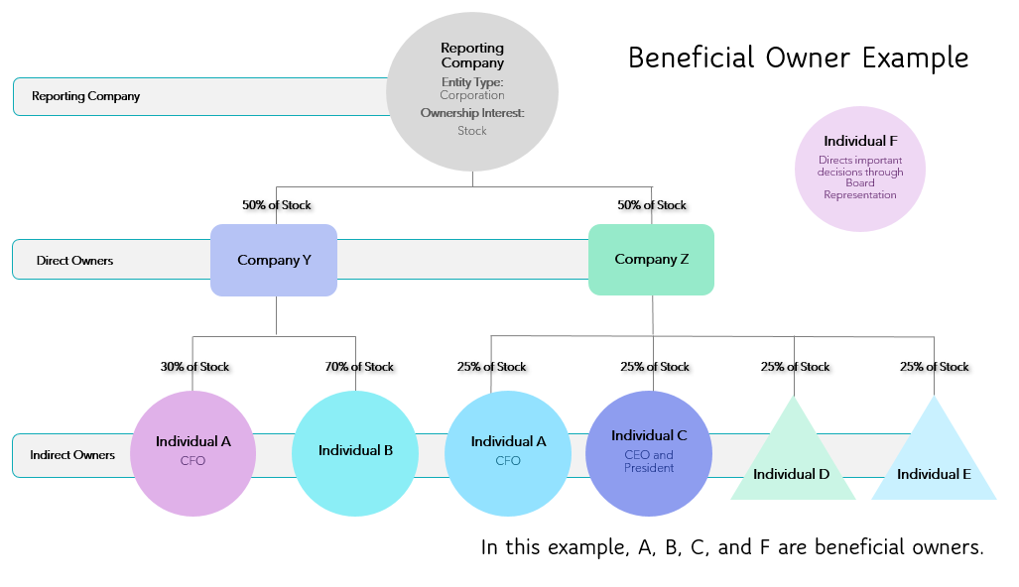
Who is a beneficial owner
A beneficial owner is any individual who, directly or indirectly:
Exercises substantial control over a reporting company; or
Owns or controls at least 25 percent of the ownership interests of a reporting company.
Complex ownership structures with multiple layers of ownership are not excused from reporting. In fact, reporting companies must get beyond direct owners -if the direct owner is an entity- to the indirect owners.
(Example; Reporting company is owned by two LLCs (Company Y and Company Z), each owning 50% of reporting company. The reporting company’s obligation does not stop at listing the two LLCs. The reporting company is obligated to determine every individual (living, breathing people) that have substantial control of the two LLCs or that own or control at least 25% of the ownership interest of the reporting company. If there are multiple layers of corporate ownership, the reporting company must keep moving up the ownership chain until it gets to individuals.)
Corporate Transparency Act (CTA) Beneficial Ownership Information Reporting
Published on12/8/2023
Visit FinCEN.GOV for complete up-to-date rules and see small entity compliance guide for nuanced explanations
Please Contact either Jack Hakim at (303) 226-6089 jhakim@messner.com or Maclain Joyce at (303)605-1561 mjoyce@messner.com for more information

Slide 8
Who is a beneficial owner
Corporate Transparency Act (CTA) Beneficial Ownership Information Reporting
Published on12/8/2023
Visit FinCEN.GOV for complete up-to-date rules and see small entity compliance guide for nuanced explanations
Please Contact either Jack Hakim at (303) 226-6089 jhakim@messner.com or Maclain Joyce at (303)605-1561 mjoyce@messner.com for more information

Slide 9
What happens if boi is not reported in the proper timeframe?
Penalties for failure to report BOI
The willful failure to report complete or updated beneficial ownership information to FinCEN, or the willful provision of or attempt to provide false or fraudulent beneficial ownership information may result in civil or criminal penalties, including civil penalties of up to $500 for each day that the violation continues, or criminal penalties including imprisonment for up to two years and/or a fine of up to $10,000. Senior officers of an entity that fail to file a required BOI report may be held accountable for that failure.
Corporate Transparency Act (CTA) Beneficial Ownership Information Reporting
Published on12/8/2023
Visit FinCEN.GOV for complete up-to-date rules and see small entity compliance guide for nuanced explanations
Please Contact either Jack Hakim at (303) 226-6089 jhakim@messner.com or Maclain Joyce at (303)605-1561 mjoyce@messner.com for more information

Slide 10
disclaimer
The information provided herein does not, and is not intended to, constitute legal advice; instead, all information, content, and materials available herein are for general informational purposes only. Information provided may not constitute the most up-to-date or complete legal or other information. This material contains links to other third-party websites. Such links are only for the convenience of the reader, user or browser; Messner Reeves does not recommend or endorse the contents of the third-party sites.
Readers of this information should contact Messner Reeves to obtain advice with respect to any particular legal matter. No reader, user, or browser of this information should act or refrain from acting on the basis of information on this site without first seeking legal advice from counsel in the relevant jurisdiction. Only your individual attorney can provide assurances that the information contained herein – and your interpretation of it – is applicable or appropriate to your particular situation. Use of, and access to, this information or any of the links or resources contained within the information do not create an attorney-client relationship between the reader, user, or browser and the authors, contributors, or contributing law firms.
The views expressed herein are those of the individual authors writing in their individual capacities only. All liability with respect to actions taken or not taken based on the contents of this information are hereby expressly disclaimed. The content on this posting is provided "as is;" no representations are made that the content is error-free.
Corporate Transparency Act (CTA) Beneficial Ownership Information Reporting
Published on12/8/2023
Visit FinCEN.GOV for complete up-to-date rules and see small entity compliance guide for nuanced explanations
Please Contact either Jack Hakim at (303) 226-6089 jhakim@messner.com or Maclain Joyce at (303)605-1561 mjoyce@messner.com for more information

